Slide 1
Future North America Priority Events Steve Preston IOTA Annual Meeting Jul 2016

Slide 2
Priority Events Full list posted at http://www.asteroidoccultation.com/2017-NA-Best.html
Priority | Date | UT |  | Asteroid | Star Mag | Dur | Dia (km) | Sigma (pw) |  | Notes
Binary | Jan 03, 2017 | 09:56 |  | (22) Kalliope | 11.5 | 18 | 209 | 0.09 |  | Canada, E USA, 0.3 mag drop
B | Jan 31, 2017 | 03:30 |  | (206) Hersilia | 8.5 | 9.9 | 94 | 0.32 |  | NC to Northern CA
B | Mar 8, 2017 | 06:40 |  | (234) Carolina | 9.0 | 12.8 | 60 | 0.43 |  | GA to CA
* | Apr 10, 2017 | 09:38 |  | (599) Luisa | 8.5 | 9.3 | 62 | 0.65 |  | VA to FL, Mexico
B | Apr 11, 2017 | 10:08 |  | (105) Artemis | 8.9 | 9.6 | 116 | 0.27 |  | ID to CA, Mexico
A | Jun 6, 2017 | 04:45 |  | (5) Astraea | 9.6 | 12.7 | 123 | 0.23 |  | FL to TX
B | Jul 18, 2017 | 05:15 |  | (412) Elisabetha | 9.9 | 9.8 | 101 | 0.60 |  | Canada, WI to NM, Mexico, Gaia?
B | Aug 23, 2017 | 03:55 |  | (834) Burnhamia | 9.1 | 6.6 | 61 | 0.57 |  | E Canada, MI to AZ, Mexico
B | Sep 4, 2017 | 05:45 |  | (124) Alkeste | 9.5 | 7.9 | 81 | 0.60 |  | VA to LA, Mexico, Gaia?
A | Sep 12, 2017 | 06:15 |  | (241) Germania | 9.0 | 18.0 | 184 | 0.18 |  | CA to WI, E Canada
A | Oct 9, 2017 | 04:00 |  | (44) Nysa | 9.4 | 16.0 | 99 | 0.16 |  | E Canada, MI to TX, Mexico
 | Oct 21, 2017 | 06:50 |  | (772) Tanete | 10.1 | 7.8 | 117 | 0.28 |  | WA to CA
B | Oct 23, 2017 | 02:30 |  | (154) Bertha | 10.2 | 11.5 | 186 | 0.21 |  | SE Canada, MI to CA
B | Nov 6, 2017 | 05:50 |  | (505) Cava | 9.0 | 20.7 | 101 | 0.44 |  | Canada, MT to AZ, Mexico, Gaia?
B | Nov 14, 2017 | 10:55 |  | (772) Tanete | 9.7 | 8.6 | 117 | 0.38 |  | E Canada, MI to FL
B | Nov 23, 2017 | 06:50 |  | (494) Virtus | 8.7 | 7.0 | 88 | 0.38 |  | FL, Mexico
* | Dec 21, 2017 | 12:25 |  | (980) Anacostia | 9.9 | 5.8 | 78 | 0.31 |  | SW USA, Mexico

Slide 3
2016 Aug 27 (85) Io / TYC 0517-00165-1 (m 7.5)

Slide 4
2016 Sep 3 (51) Nemausa / HIP 8524 (m 7.6)

Slide 5
2016 Sep 14 (372) Palma / TYC 5223-00545-1 (m10.3)

Slide 6
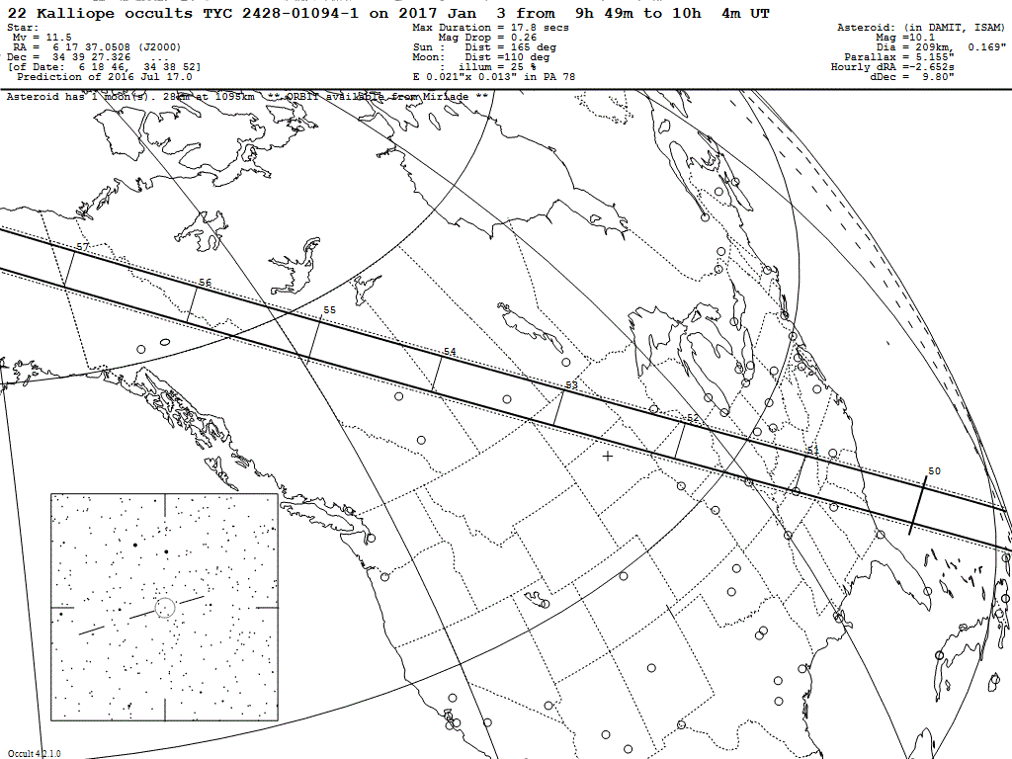
2017 Jan 3 (22) Kalliope / TYC 2428-01094-1 (m 11.5)

Slide 7
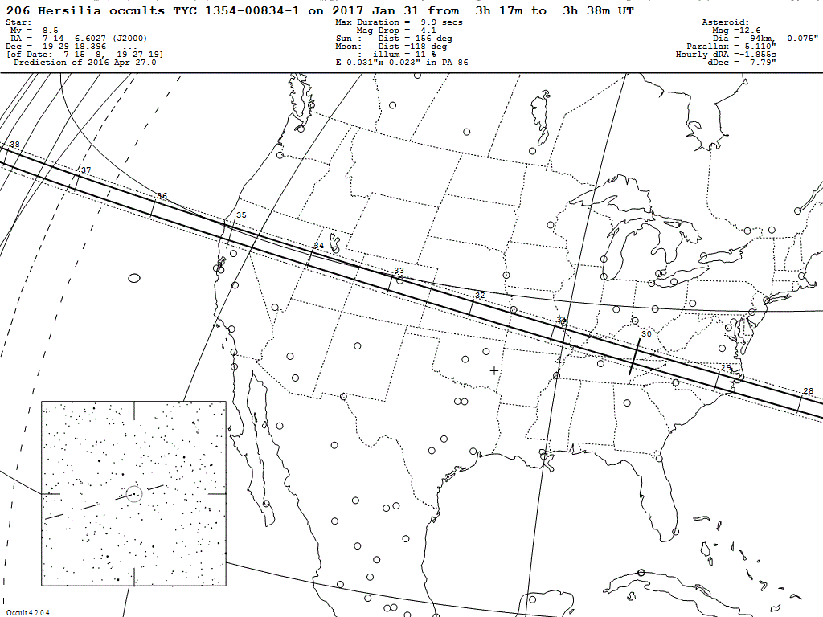
2017 Jan 31 (206) Hersilia / TYC 1354-00834-1 (m 8.5)

Slide 8
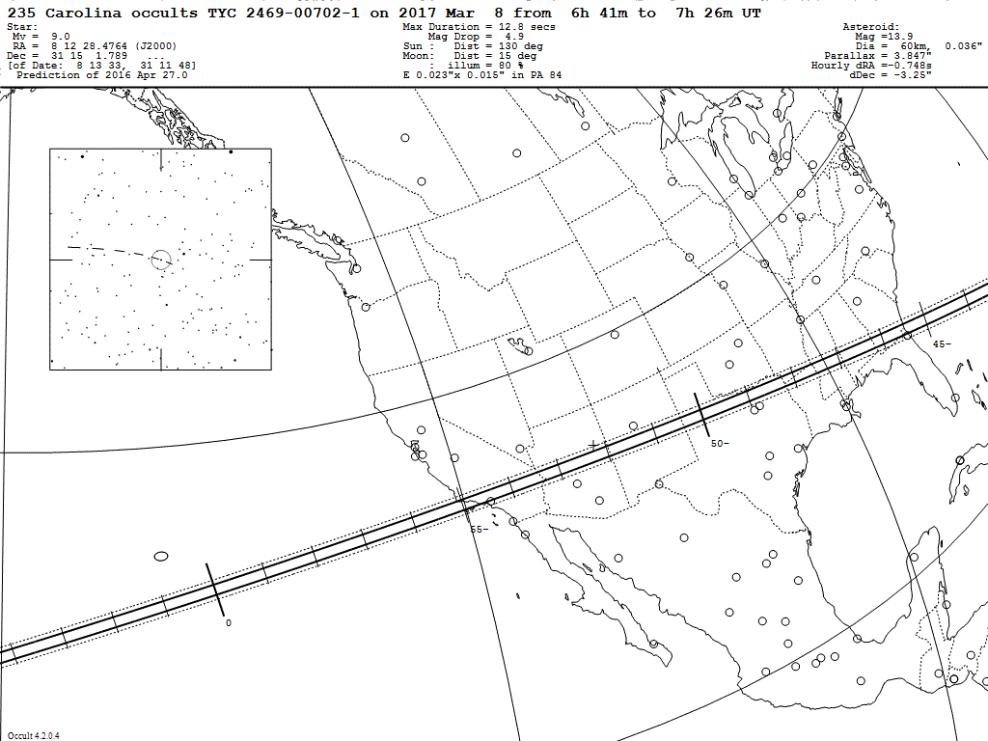
2017 Mar 8 (235) Carolina / TYC 2469-00702-1 (m 9.0)

Slide 9
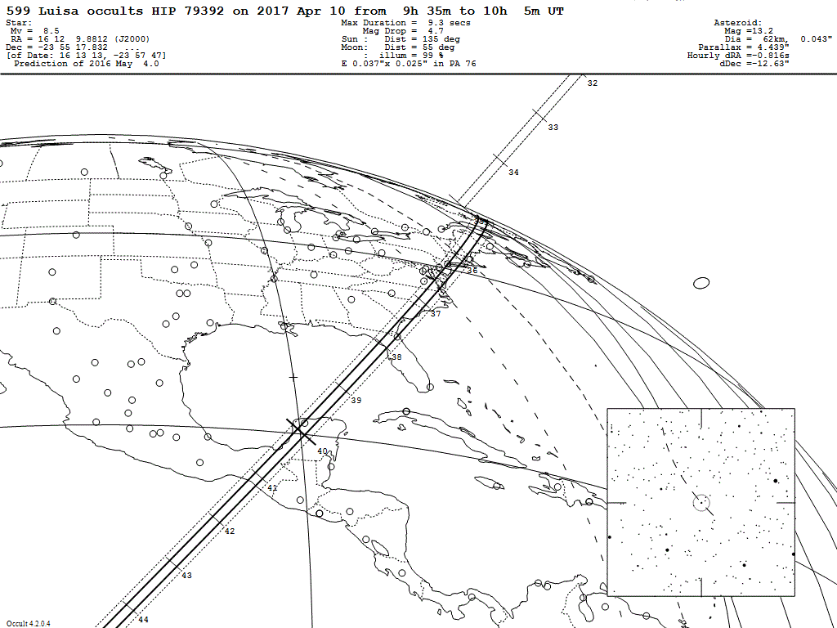
2017 Apr 10 (599) Luisa / HIP 79392 (m 8.5)

Slide 10
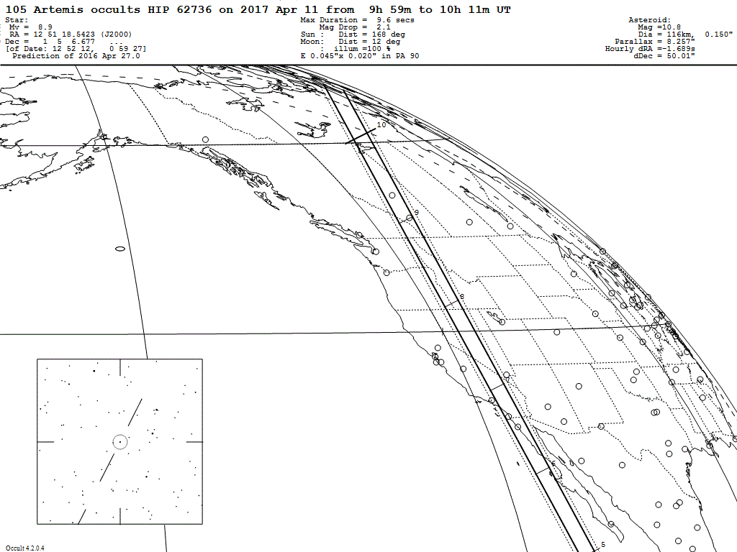
2017 Apr 11 (105) Artemis / HIP 62736 (m 8.9)

Slide 11
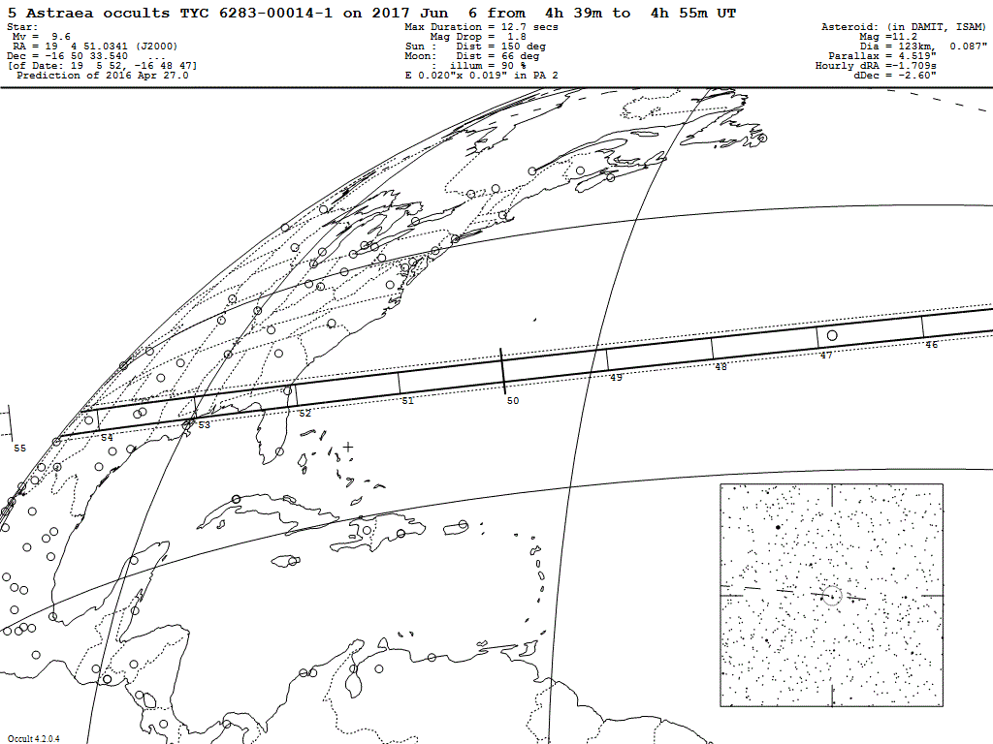
2017 Jun 6 (5) Astraea / TYC 6283-00014-1 (m 9.6)

Slide 12
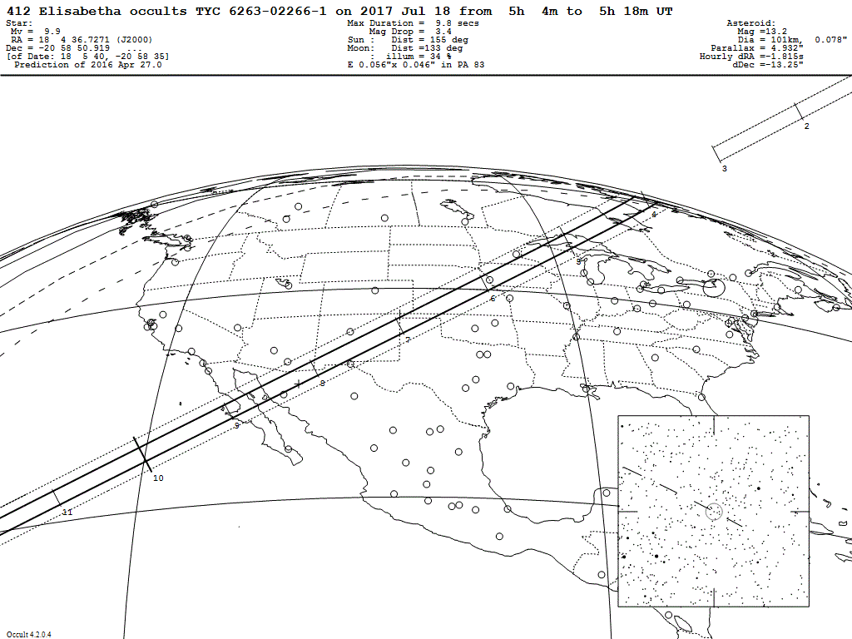
2017 Jul 18 (412) Elisabetha / TYC 6263-02266-1 (m 9.9)

Slide 13
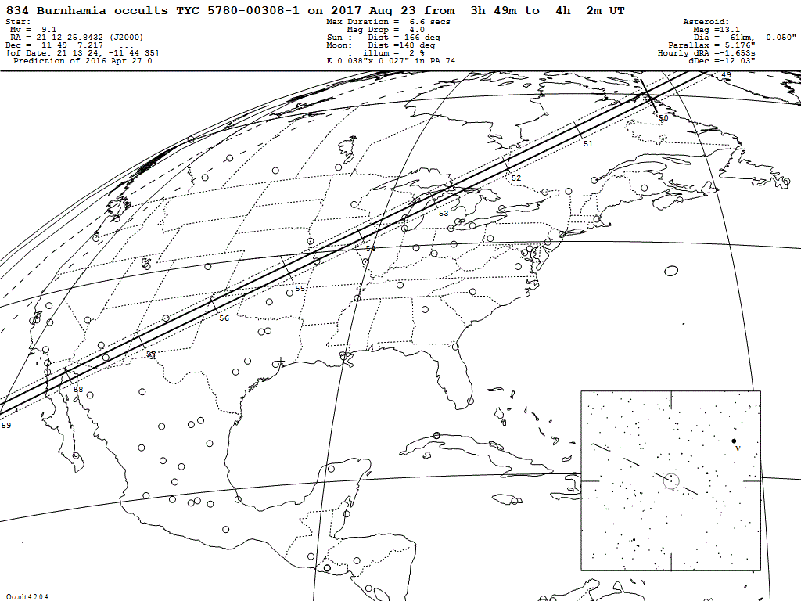
2017 Aug 23 (834) Burnhamia / TYC 5780-00308-1 (m 9.1)

Slide 14
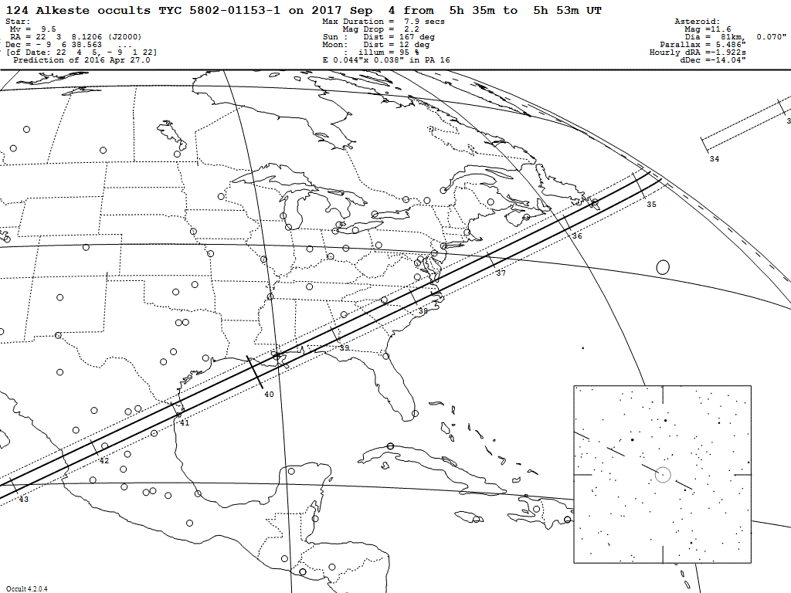
2017 Sep 4 (124) Alkeste / TYC 5802-01153-1 (m 9.5)

Slide 15
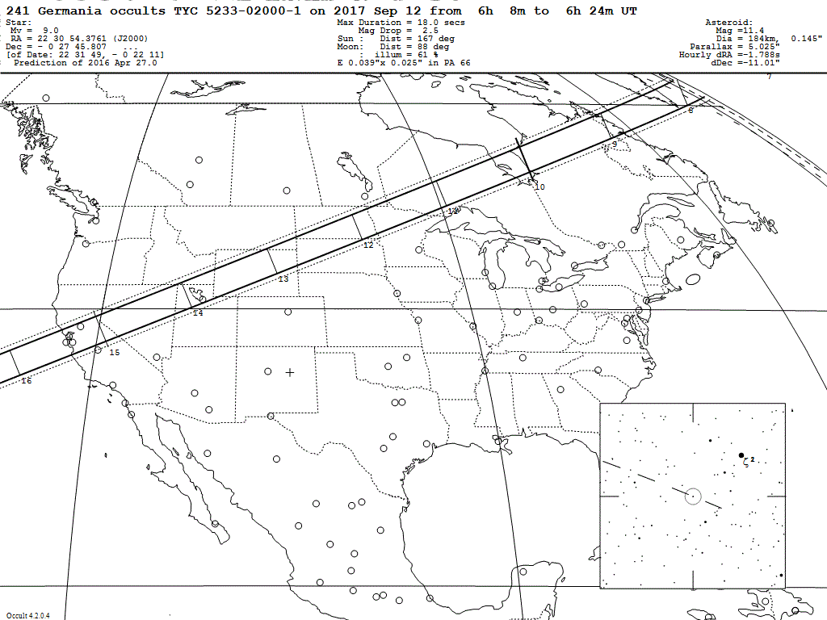
2017 Sep 12 (241) Germania / TYC 5233-02000-1 (m 9.0)

Slide 16
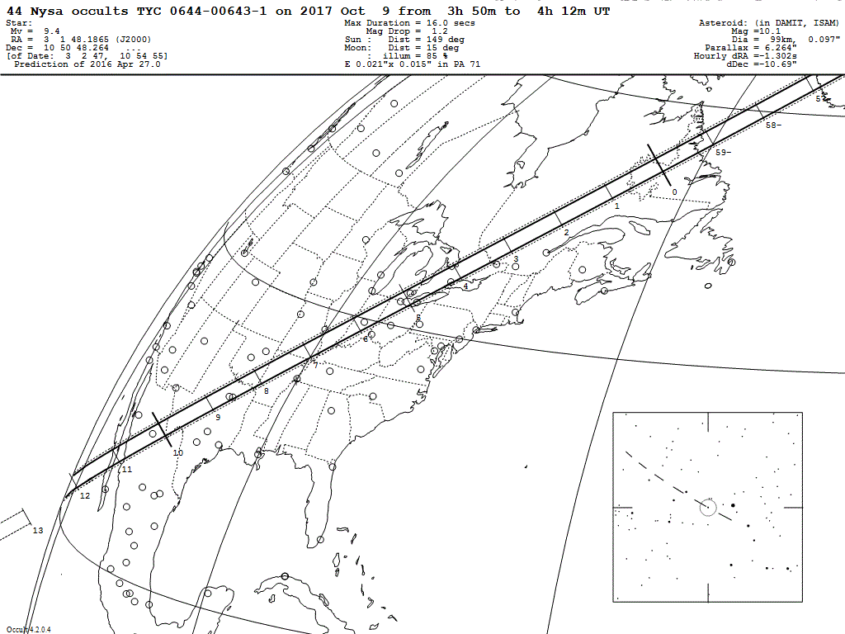
2017 Oct 9 (44) Nysa / TYC 0644-00643-1 (m 9.4)

Slide 17
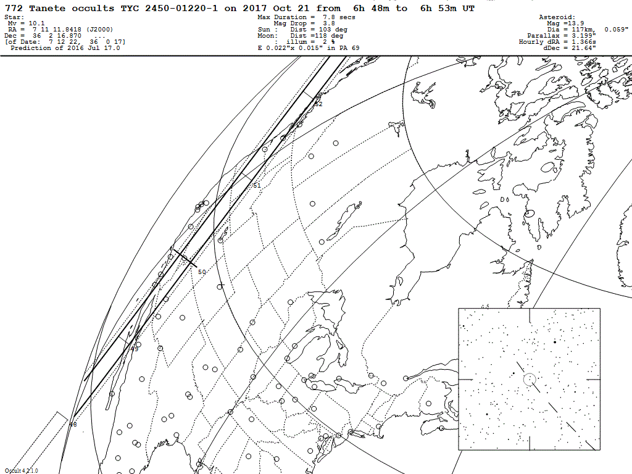
2017 Oct 21 (772) Tanete / TYC 2450-01220-1 (m 10.1)

Slide 18
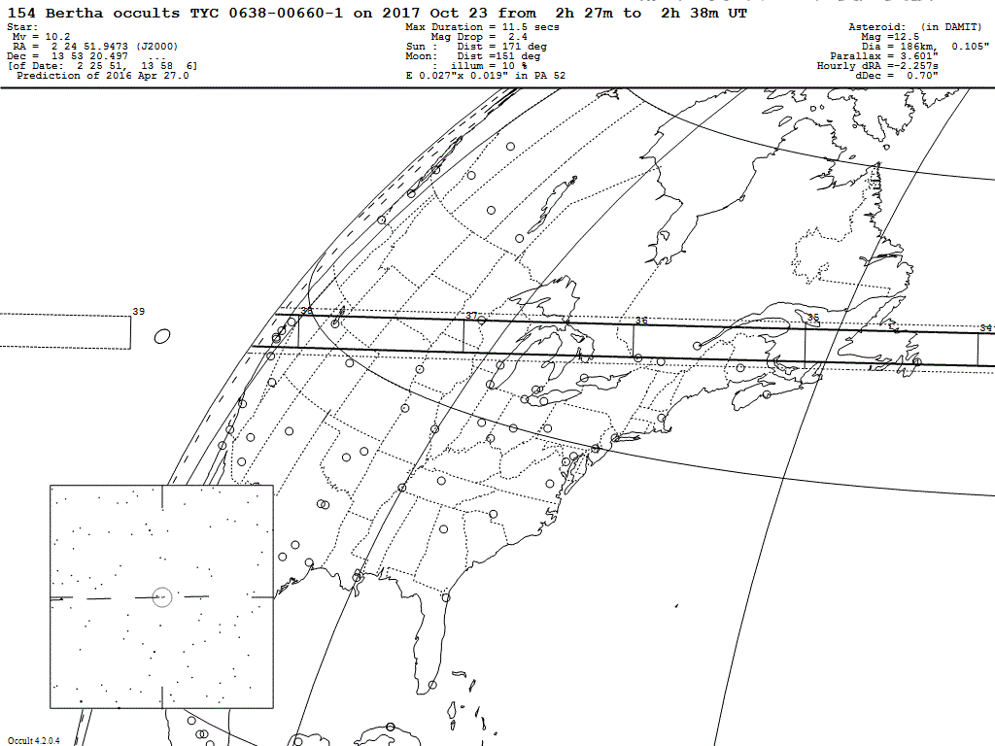
2017 Oct 23 (154) Bertha / TYC 0638-00660-1 (m 10.2)

Slide 19
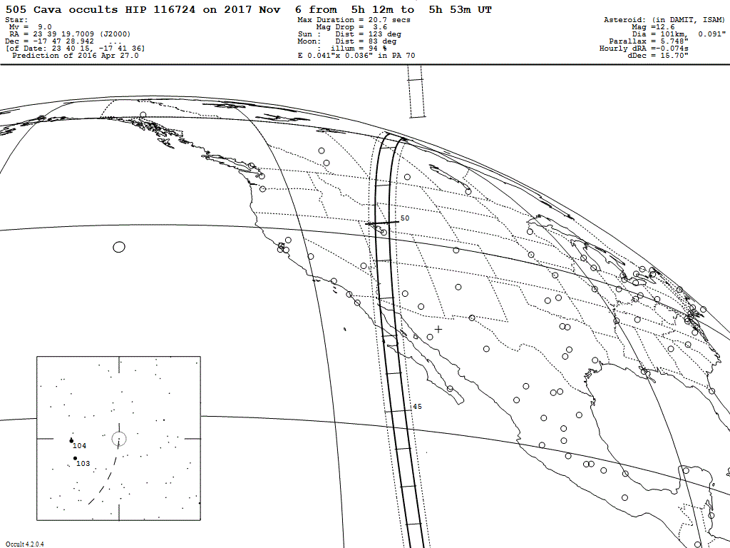
2017 Nov 6 (505) Cava / HIP 116724 (m 9.0)

Slide 20
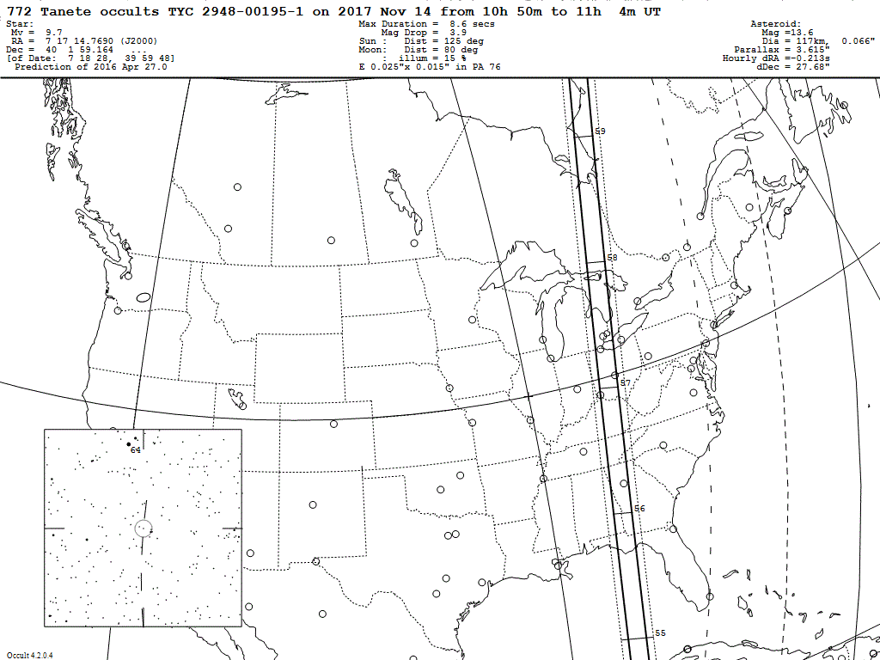
2017 Nov 14 (772) Tanete / TYC 2948-00195-1 (m 9.0)

Slide 21
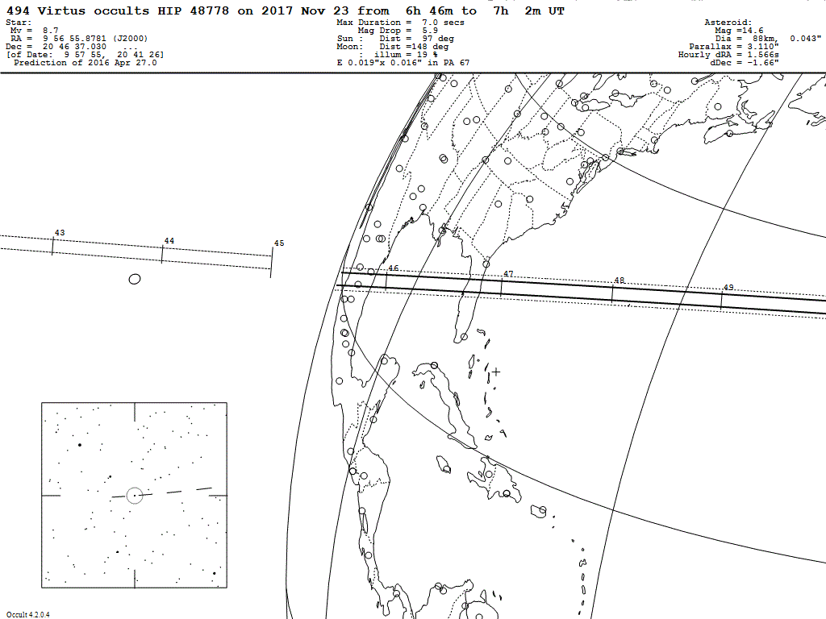
2017 Nov 23 (494) Virtus / HIP 48778 (m 8.7)

Slide 22
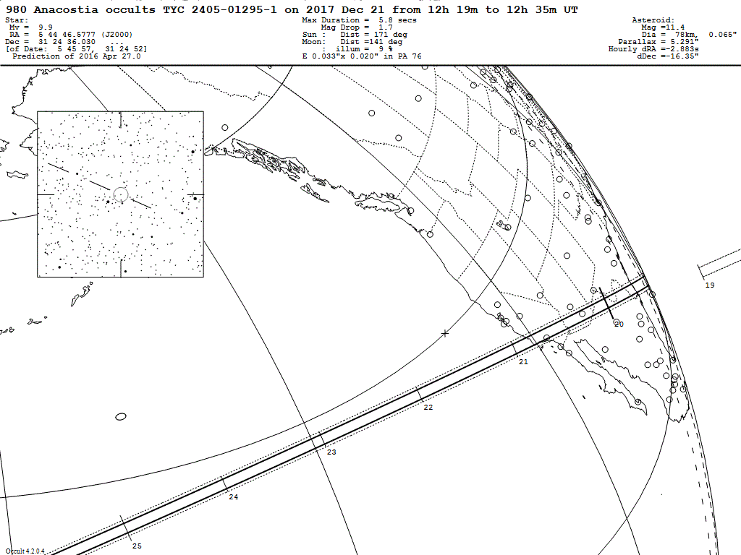
2017 Dec 21 (980) Anacostia / TYC 2405-01295-1 (m 9.9)

